Slide 1

深度学习TensorFlow下的计算机视觉
http://hacker.duanshishi.com
https://github.com/burness
Burness Duan
UCloud

Slide 2
OUTLINE
TensorFlow Features
TensorFlow And Deep CV
TFLearn Introduction

Slide 3
TensorFlow Features
Programming Model and Basic Concepts
Implementation
Extensions
Optimizations
Abadi M, Agarwal A, Barham P, et al. TensorFlow: Large-scale machine learning on heterogeneous systems, 2015[J]. Software available from tensorflow. org, 2015, 1.

Slide 4
Programming Model and Basic Concepts
Notes:
Node: 每一个node有零或者多个输入，代表一个操作实例，node间的普通数据流成为tensor，特殊的边没有数据流动，控制依赖

Slide 5
Programming Model and Basic Concepts
Operations and Kernels
Sessions
Variables

Slide 6
Programming Model and Basic Concepts
Operation: An abstract computation, can have attributes
Kernel: A particular implementation of an operation that can be run a particular type of device(CPU or GPU)
Sessions: Interact with the TensorFlow system, Run the full graph or a few distinct subgraphs
Variables: A speical operation returns a handle to a persistent mutable tensor
https://www.tensorflow.org/versions/r0.11/how_tos/adding_an_op/index.html
https://github.com/tensorflow/tensorflow/commit/7b7c02de56e013482b5fe5ab05e576dc98fe5742
Notes:
如果不了解这两个基本概念，看如何为TensorFlow自定义增加一个op就完全看不懂了，主要流程1.Register the new Op in a C++ file；2. Implement the Op in C++；3，Optionally, create a Python wrapper；4，Optionally, write a function to compute gradients for the Op.
；5，Test and Validation

Slide 7
Implementation
Single-Device Execution
Multi-Device Execution
Distributed Execution
Node Placement
Cross-Device Communication

Slide 8
Single-Device Execution
The nodes of the graph are executed in an order that respects the dependencies between the nodes

Slide 9
Multi-Device Execution
Node Placement：Based on heuristics associated with different operation types or is measured based on an actual set of placement decisions for earlier extentions of the graph
Notes:
Node Placement : map the computation onto the set of available devices, estimates of the sizes of the input and output tensors for each graph node
Tensorflow 内部有一个分配机制，会在多devices时给任务分配给各个节点资源

Slide 10
Multi-Device Execution
Cross-Device Communication:
Notes:
Any Cross-device edges 如 x-> y会被替代为x到send 以及相应地receive node到y。从a->c a->b会提前对图分析，只需要一次分配，无需多次分配

Slide 11
Distributed Execution
Similar to multi-device execution, After device placement, a subgraph is created per device. Send/Receive node communicate across woker processes use remote communication such as TCP or RDMA.
Notes:
Distributed execution 类似于multi device exection，只是操作会通过一些网络协议来进行数据的传输

Slide 12
Distributed TensorFlow Example
Distributed_tensorflow.py
Notes:
Distributed execution 类似于multi device exection，只是操作会通过一些网络协议来进行数据的传输

Slide 13
Extensions
Gradient Computation
Partial Execution
Device Constraints
Control Flow
Input Operations
Queues
Containers
TF hold a lot of GPU memmory
Run the nodes with the deps of the out tensor
You can define which nodes run on the specify devices
Allow us to skip the execution of an subgraph based on the
Value of a boolean tensor
From the storage system to the worker
Allow the inpu data to be prefeteched from disk files while a previous
batch of data is being processed
Share state even across completely disjoint computation graphs
Notes:
Any Cross-device edges 如 x-> y会被替代为x到send 以及相应地receive node到y。从a->c a->b会提前对图分析，只需要一次分配，无需多次分配

Slide 14
Gradient Computation

Slide 15
Partial Execution
Notes:
Run 输出某个tensor时只计算只有与其有依赖关系的某些子图，不一定计算full-graph

Slide 16
Device Constraints
Client can control the placement of nodes on devices by providing partial constraints for a node about
Which devices it can execute on.
Notes:
通过语句配置某些node在专门的devices上运行。

Slide 17
Control Flow
High-level programming constructs such if-conditionals and while-loops can be easily compiled
Into dataflow graph with these control flow operators.

Slide 18
Input Operations
An special node in graph: efficient mechanism used for training large-scale machine learning models
Notes:
直接从存储系统中读入文件到机器内存来做数据的处理，input node 能够直接从文件系统到对应的worker。

Slide 19
Queues
Allow input data to prefetched from disk files while a previous batch of data is still being processed
by the model
Notes:
当model在处理对应batch的数据时， 能够开始从disk中读入更多的batch，不会等待

Slide 20
Containers
Allow input data to prefetched from disk files while a previous batch of data is still being processed
by the model
Notes:
当model在处理对应batch的数据时， 能够开始从disk中读入更多的batch，不会等待

Slide 21
Optimizations
Common Subexpression Elimination
Asynchronous Kernels
Optimized Libraries for Kernel Implementation
Notes:
Any Cross-device edges 如 x-> y会被替代为x到send 以及相应地receive node到y。从a->c a->b会提前对图分析，只需要一次分配，无需多次分配

Slide 22
Common Subexpression Elimination
Convert the redundant copies of the same computation to just a single one
Notes:
网络的复杂操作有很多相同计算，Common Subexpression Elimination用来优化这部分，值需要计算一个即可

Slide 23
Asynchronous Kernels
Non-blocking kernels，avoid tying up an execution thread for unbounded periods of time while waiting for I/O or other events.
Notes:
异步核， 比如Receive kernel Enqueue and Dequeue kernels，能够异步去执行，避免频繁的等待时间。

Slide 24
Optimized Libs For Kernel Implementations
Eigen\BLAS\cuBLAS, GPU CNN Kernel: cuda-convnet, cuDNN

Slide 25
TensorFlow And Deep CV
Image Classification
Neural Style
Txt2Img, img2txt

Slide 26
Image Classification
Training from scratch
Retrain from pre-trained model
Load model and frozen some layers’ weights and retrain the other layers
Notes:
做一种图像分类通常有三种方法：1，从头训练某种网络结构用来进行图像识别；2，重新训练某个pre-trained model，更改类别，然后fit数据进行模型训练；3，同样是利用pre-trained model，load所有layers的参数，frozen其中某些层参数，fit数据进行模型训练。

Slide 27
Training from scratch
mnist = input_data.read_data_sets(FLAGS.data_dir, one_hot=True)
x = tf.placeholder(tf.float32, [None, 784])
W = tf.Variable(tf.zeros([784, 10]))
b = tf.Variable(tf.zeros([10]))
y = tf.matmul(x, W) + b
y_ = tf.placeholder(tf.float32, [None, 10])
cross_entropy = tf.reduce_mean(tf.nn.softmax_cross_entropy_with_logits(y, y_))
train_step = tf.train.GradientDescentOptimizer(0.5).minimize(cross_entropy)
sess = tf.InteractiveSession()
tf.initialize_all_variables().run()
for _ in range(1000):
batch_xs, batch_ys =mnist.train.next_batch(100)
sess.run(train_step, feed_dict={x: batch_xs, y_: batch_ys})
correct_prediction = tf.equal(tf.argmax(y, 1), tf.argmax(y_, 1))
accuracy = tf.reduce_mean(tf.cast(correct_prediction, tf.float32))
print(sess.run(accuracy, feed_dict={x: mnist.test.images, y_: mnist.test.labels}))
TRAIN DATA
INIT
PARAMS
MODEL
TEST
DATA
TEST
LABELS

Slide 28
Retrain from pre-trained model
Load pre params from a model file(pb，ckpt)
Change your model to the new task(class num)
Fit the train data to update the all weights
Fit your test data to inference
TRAIN DATA
PRE
PARAMS
MODEL
TEST
DATA
TEST
LABELS
Notes:
做一种图像分类通常有三种方法：1，从头训练某种网络结构用来进行图像识别；2，重新训练某个pre-trained model，更改类别，然后fit数据进行模型训练；3，同样是利用pre-trained model，load所有layers的参数，frozen其中某些层参数，fit数据进行模型训练。

Slide 29
Retrain from pre-trained model (frozen)
Load pre params from a model file(pb)
Frozen your layers’ weight
Change the network’s class num
Fit your train data to update the unfrozen layers’ weight
Fit your test data to inference
TRAIN DATA
PRE
PARAMS
FROZEN
MODEL
TEST
DATA
TEST
LABELS
https://github.com/spark-mler/WorkWithTensorflow/tree/master/cv_bot/models/pretrain_inference
Notes:
做一种图像分类通常有三种方法：1，从头训练某种网络结构用来进行图像识别；2，重新训练某个pre-trained model，更改类别，然后fit数据进行模型训练；3，同样是利用pre-trained model，load所有layers的参数，frozen其中某些层参数，fit数据进行模型训练。

Slide 30
Neural Style
MRF-Based
CNN-Based
MRF and CNN-Based
Fast Neural Style
Notes:
Neural style 是图像合成的一个经典的东西
最开始的图像合成主要是基于MRF的方法
然后 CNN, 也有MRF+CNN
然后fast neural style

Slide 31
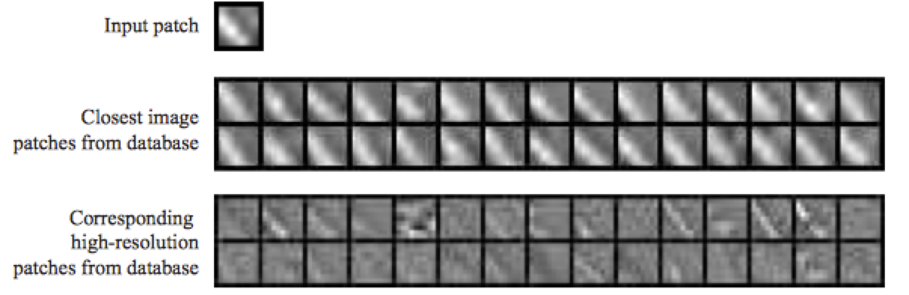
MRF-Based
Freeman W T, Liu C. Markov random fields for super-resolution and texture synthesis[J]. Advances in Markov Random Fields for Vision and Image Processing, 2011, 1: 155-165.
Efros A A, Leung T K. Texture synthesis by non-parametric sampling[C]//Computer Vision, 1999. The Proceedings of the Seventh IEEE International Conference on. IEEE, 1999, 2: 1033-1038.
Notes:
MRF在图像分割、图像合成这块很经典的方法
Markov 随机场定义的直观意义是,xs 只受到其周围的点即Xr 的影响,而与其它的点无关“ 纹理合成所采用的 Markov Random Field (MRF)模型,是根据结果图中当前待合成像素点的邻域(或当前待合成纹理块的边界),在样本图中搜索所有像素(或纹理块),得到具有匹配邻域的像素点(或具有匹配边界的纹理块),将其作为当前待合成像素点(或纹理块)的最佳近似合成到结果图中”MRF模型认为纹理具有局部统计特征即纹理中的任一部分都可以由其周围部分(即邻域)来完全决定,这是对纹理的一种比较客观的认识“Markov 模型能够较好的刻画纹理的高阶统计特性
问题是只能考虑local的信息影响，不能再图像语义 全局上做更多的涉及

Slide 32
CNN-Based
Gatys L A, Ecker A S, Bethge M. A neural algorithm of artistic style[J]. arXiv preprint arXiv:1508.06576, 2015.
https://github.com/anishathalye/neural-style
https://github.com/jcjohnson/neural-style
Notes:
使用pre-trained的model，关键在于如何定义content loss 和style loss
Content Reconstruction: 上图中下面部分是Content Reconstruction对应于CNN中的a，b，c，d，e层，注意最开始标了Content Representations的部分不是原始图片（可以理解是给计算机比如分类器看的图片，因此如果可视化它，可能完全就不知道是什么内容），而是经过了Pre-trained之后的VGG network model的图像数据， 该model主要用来做object recognition， 这里主要用来生成图像的Content Representations。理解了这里，后面就比较容易了，经过五层卷积网络来做Content的重构，文章作者实验发现在前3层的Content Reconstruction效果比较好，d，e两层丢失了部分细节信息，保留了比较high-level的信息。
Style Reconstruction： Style的重构比较复杂，很难去模型化Style这个东西，Style Represention的生成也是和Content Representation的生成类似，也是由VGG network model去做的，不同点在于a,b,c,d,e的处理方式不同，Style Represention的Reconstruction是在CNN的不同的子集上来计算的，怎么说呢，它会分别构造conv1_1(a),[conv1_1, conv2_1](b),[conv1_1, conv2_1, conv3_1],[conv1_1, conv2_1, conv3_1,conv4_1],[conv1_1, conv2_1, conv3_1, conv4_1, conv5_1]。这样重构的Style 会在各个不同的尺度上更加匹配图像本身的style，忽略场景的全局信息。

Slide 33
MRF And CNN-Based
Li C, Wand M. Combining Markov Random Fields and Convolutional Neural Networks for Image Synthesis[J]. arXiv preprint arXiv:1601.04589, 2016
https://github.com/chuanli11/CNNMRF
Notes:
MRF model 问题：local区域的统计信息无法建模复杂图像下的全局信息，优点。
Combined MRF and CNN:
We transfer the style of x s into the layout of x_c by making the high-level neural encoding of x similar to x_c , but using local patches similar to those of x_s . The latter is the MRF prior that maintains the encoding of the style.
1，content的encode还是基于nn来做的和原来的方法一样；
2，style是采用MRF prior local patches来对style来进行编码，和neural style的方法不一样；

Slide 34
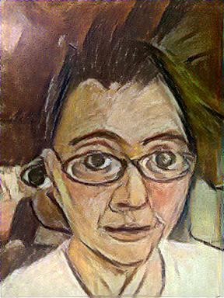
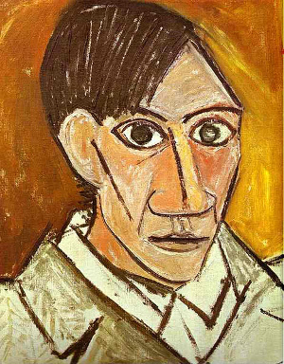

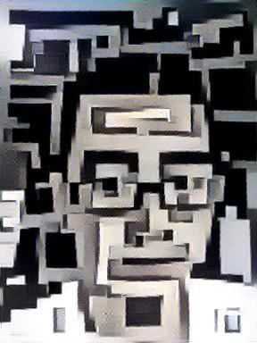



MRF And CNN-Based
Notes:
MRF model 问题：local区域的统计信息无法建模复杂图像下的全局信息，优点。
Combined MRF and CNN:
We transfer the style of x s into the layout of x_c by making the high-level neural encoding of x similar to x_c , but using local patches similar to those of x_s . The latter is the MRF prior that maintains the encoding of the style.
1，content的encode还是基于nn来做的和原来的方法一样；
2，style是采用MRF prior local patches来对style来进行编码，和neural style的方法不一样；

Slide 35
Fast Neural Style
Johnson J, Alahi A, Fei-Fei L. Perceptual losses for real-time style transfer and super-resolution[J]. arXiv preprint arXiv:1603.08155, 2016.
https://github.com/burness/neural_style_tensorflow/tree/master/fast_neural_style
Notes:
Fast neural style
image transformation network、 loss netwrok；Image Transformation network是一个deep residual conv netwrok，用来将输入图像（content image）直接transform为带有style的图像；而loss network参数是fixed的，这里的loss network和A Neural Algorithm of Aritistic Style中的网络结构一致，只是参数不做更新，只用来做content loss 和style loss的计算，这个就是所谓的perceptual loss，作者是这样解释的为Image Classification的pretrained的卷积模型已经很好的学习了perceptual和semantic information（场景和语义信息），所以后面的整个loss network仅仅是为了计算content loss和style loss，而不像A Neural Algorithm of Aritistic Style做更新这部分网络的参数，这里更新的是前面的transform network的参数，所以从整个网络结构上来看输入图像通过transform network得到转换的图像，然后计算对应的loss，整个网络通过最小化这个loss去update前面的transform network

Slide 36
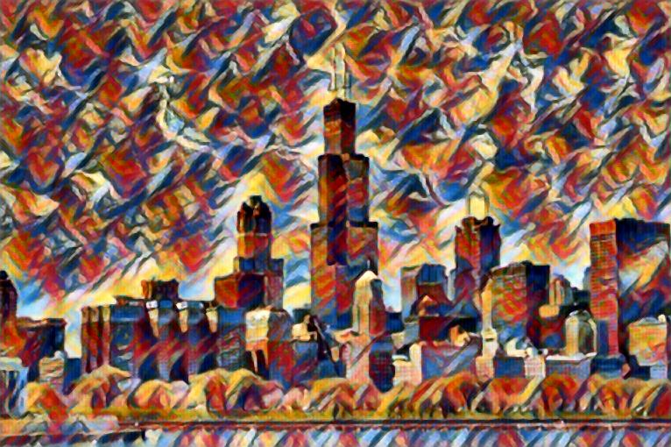



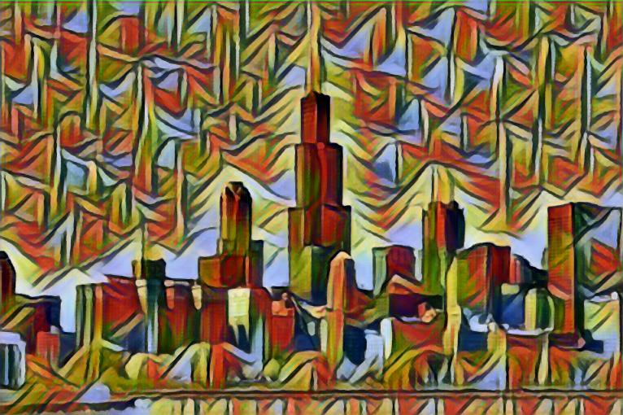
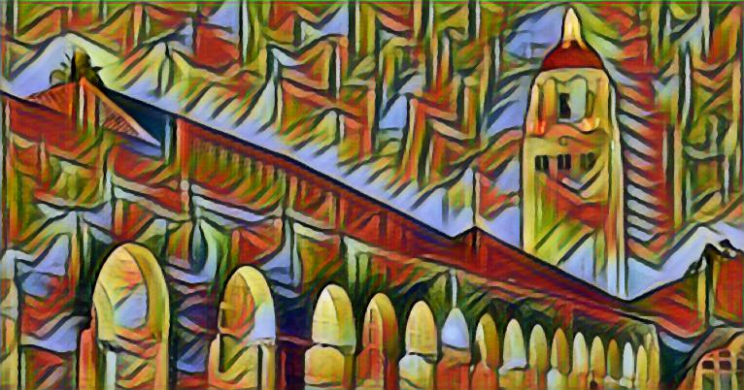
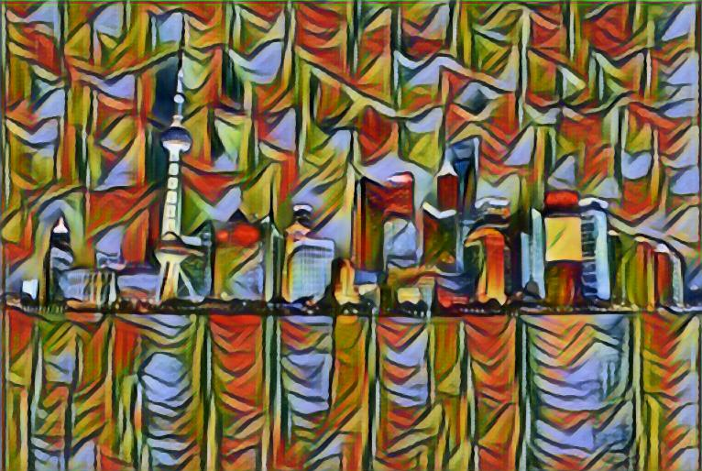
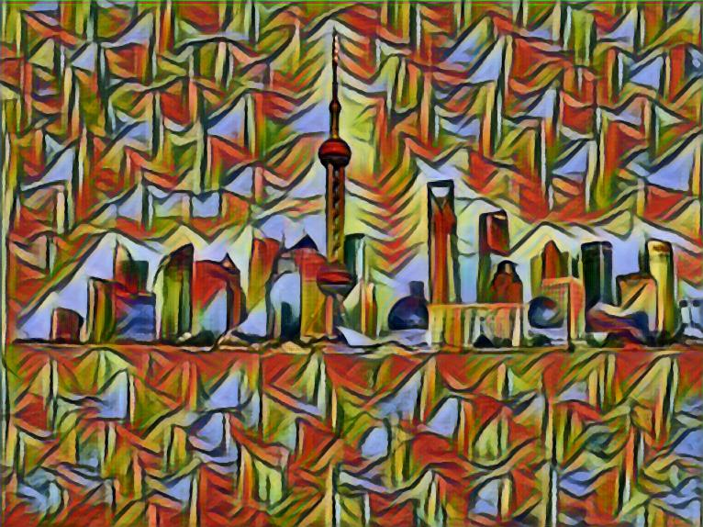
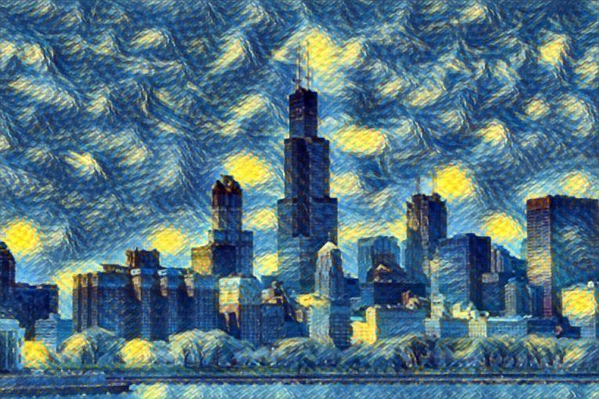
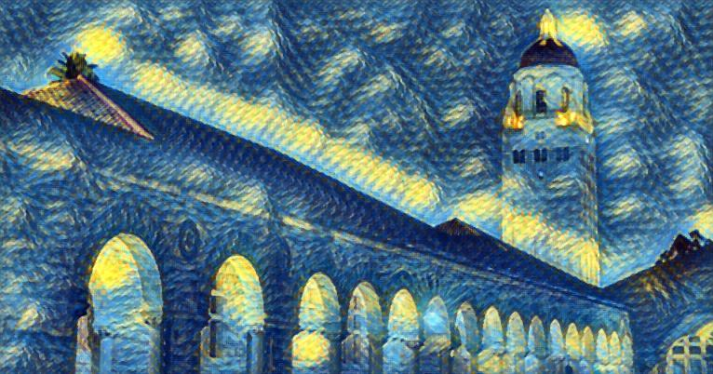

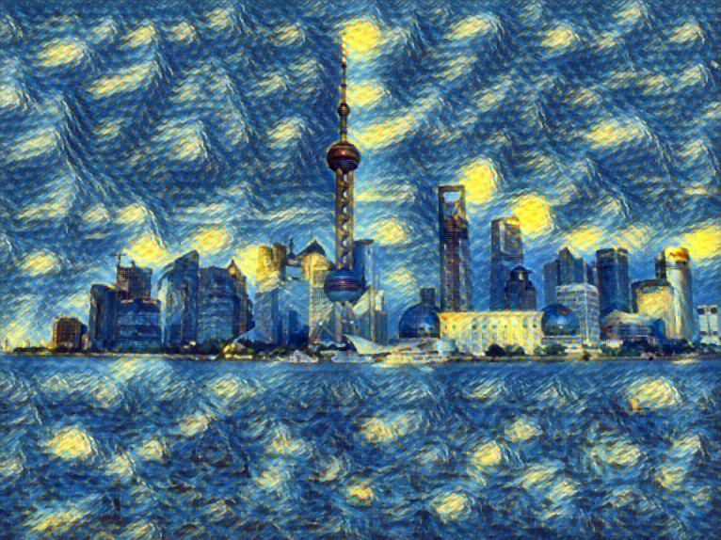




Fast Neural Style

Slide 37
Text⬄Image
Text-to-Image
Image-to-Text

Slide 38
Text-to-Image
Generative Adversarial Network
Generator G and a discriminator D compete in a two-player minimax game
G: fool the discriminator
D: Distinguish real training data from synthetic images
Reed S, Akata Z, Yan X, et al. Generative adversarial text to image synthesis[J]. arXiv preprint arXiv:1605.05396, 2016.
https://github.com/paarthneekhara/text-to-image
http://www.jianshu.com/p/db87c51de510
Notes:
GAN同时要训练一个生成网络(Generator)和一个判别网络(Discriminator)，前者输入一个noise变量 z ，输出一个伪图片数据 G(z;θg)，后者输入一个图片(real image)/伪图片(fake image)数据 x ，输出一个表示该输入是自然图片或者伪造图片的二分类置信度 D(x;θd)，理想情况下，判别器 D需要尽可能准确的判断输入数据到底是一个真实的图片还是某种伪造的图片，而生成器G又需要尽最大可能去欺骗D，让D把自己产生的伪造图片全部判断成真实的图片。

Slide 39

Text-to-Image
Generative Adversarial Network
G: $ℝ^{Z}×ℝ^{T}→ℝ^{D}$
D: $ℝ^{T}×ℝ^{D}→\left\{0,1\right\}$
Notes:
Generator network用带噪声的text encoder vector（hybrid of character-level convnet with a recurrent neural network）去生成image，尽量去fool discriminator Network， Discriminator输入real/fake, learn the score as fake

Slide 40


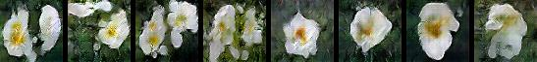


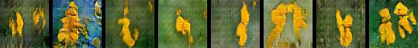
Text-to-Image
Results
the flower shown has yellow anther red pistil and bright red petals
this flower has petals that are yellow, white and purple and has dark lines
the petals on this flower are white with a yellow center
this flower has a lot of small round pink petals
this flower is orange in color, and has petals that are ruffled and rounded
the flower has yellow petals and the center of it is brown

Slide 41
Image-to-Text
Vinyals O, Toshev A, Bengio S, et al. Show and Tell: Lessons learned from the 2015 MSCOCO Image Captioning Challenge[J]. 2016.
https://github.com/tensorflow/models/tree/master/im2txt
https://github.com/tensorflow/models/issues/480
https://github.com/tensorflow/models/pull/485/commits/c6a4f783080c5310ce0e3244daa31af57df12def
Notes:
NIC：Neural Image Caption
Bug: build with the source from github, tf.gfile error when preprocess the images to be tfrecord， fixed by using the open().
整个训练时间太长，结果还没有run出来

Slide 42
Image-to-Text
Ioffe S, Szegedy C. Batch normalization: Accelerating deep network training by reducing internal covariate shift[J]. arXiv preprint arXiv:1502.03167, 2015.
Deep Visual-Semantic Alignments for Generating Image Descriptions Andrej Karpathy, Li Fei-Fei
Notes:
很容易p(s_t|I, S_0,…,S_t-1)很容易被recurrent neural network建模
where θ are the parameters of our model, I is an image, and S its correct transcription.
S represents any sentence, its length is unbounded, 所以使用RNN(LSTM)
图像的表示使用CNN（batch normalization），and change the model in cvpr 15
其他细节可能需要去阅读源码，很有意思
携程之前有李健team做过这块的分享
Image cnn model batch normalization model,然后fit到lstm来进行相应nlp相关的train

Slide 43
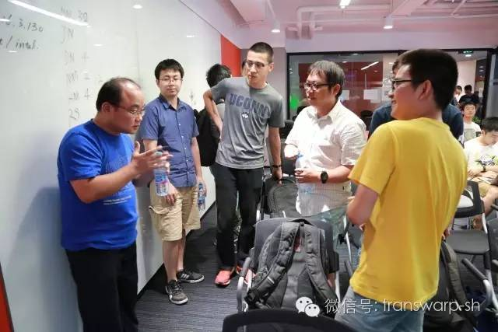
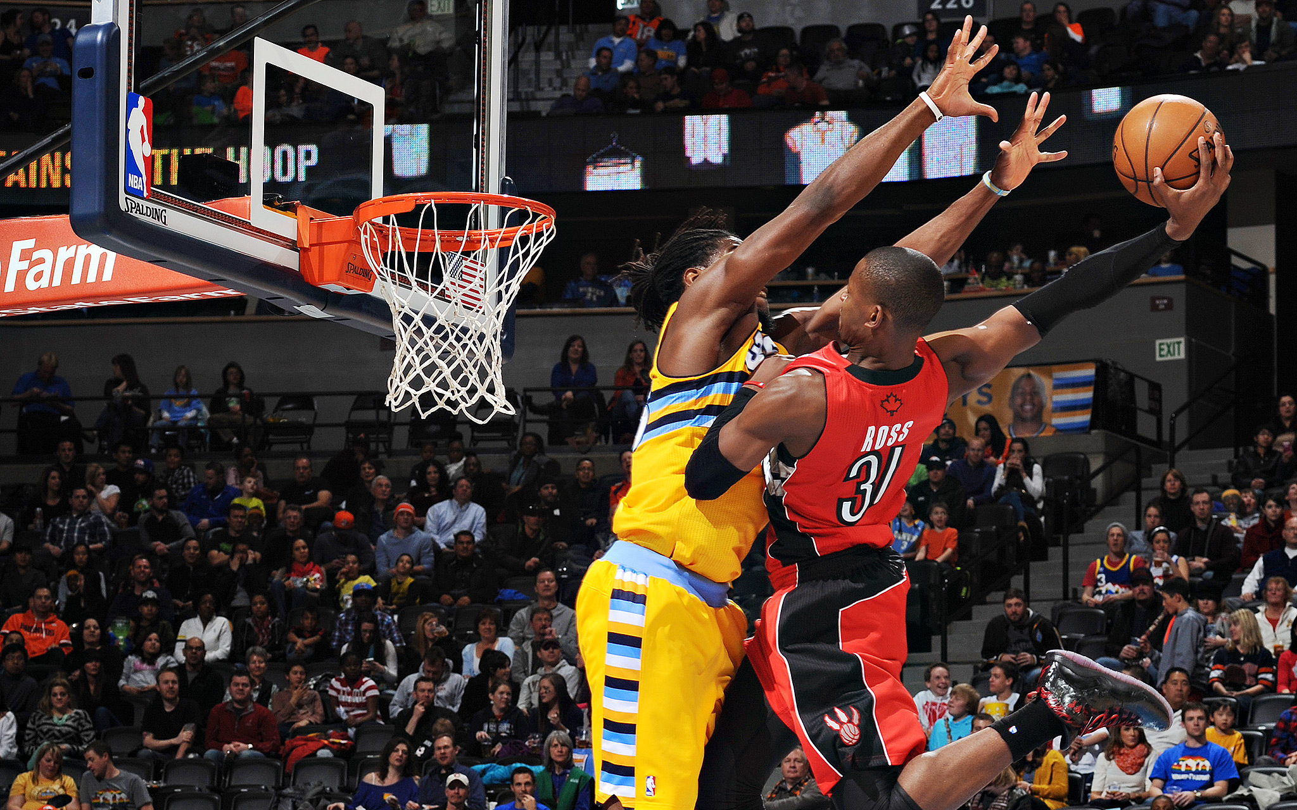

Slide 44
TFLearn Introduction

Slide 45
TFLearn Example

Slide 46
THANKS
&
QA

